Slide 1
Spatial Data Analysis (SDA)

Slide 2
Classes of problems in SDA
Spatial Point Patterns
Geostatistical (Spatially continuous) Data
Areal Data
Interaction Data

Slide 3
Point Patterns
Concerned with locations of particular point events, and we want to investigate whether the proximity of the events, their locations in relation to each other, represents a 'significant' pattern.
If we find clustering, say, we may then be interested in the question of over what spatial and/or temporal scales this occurs, and in whether particular spatial aggregations, or clusters, are associated with proximity to particular sources of some other factor.

Slide 4
R code
library(spatstat)
?redwood
?cells
plot(redwood)
plot(cells)

Slide 5
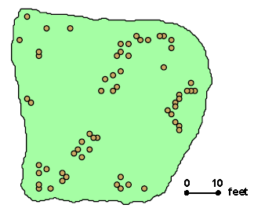
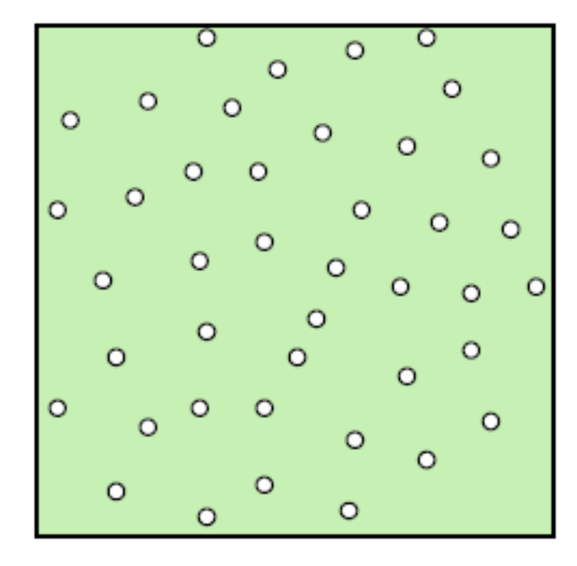
redwood
cells
The key question to be addressed here is how we can distinguish these patterns statistically in a manner that will allow us to conclude that the first is “clustered” and the second is “dispersed” – without knowing anything else about these patterns.

Slide 6
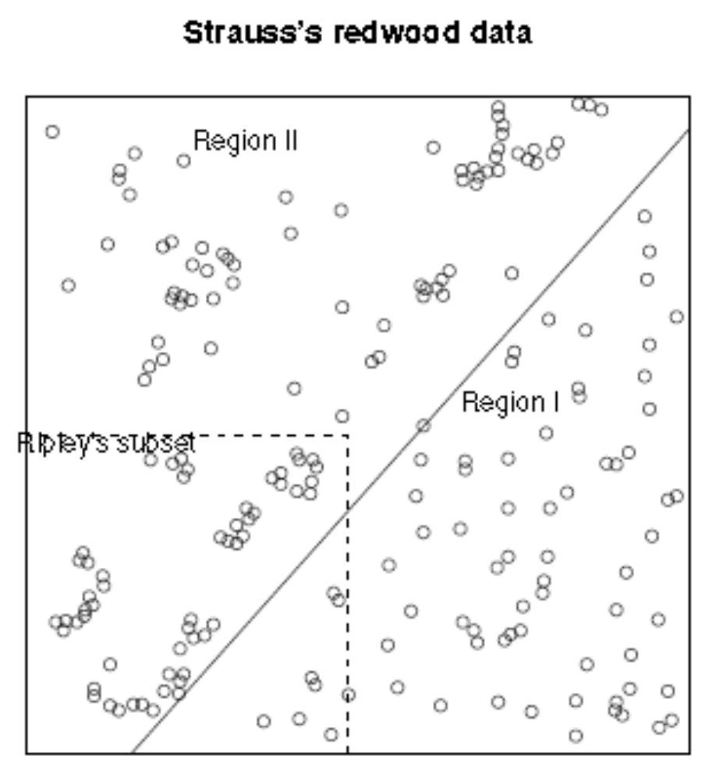

Slide 7
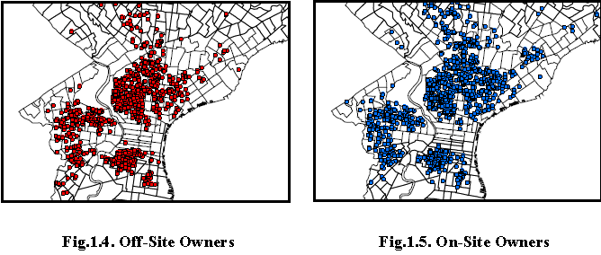
Comparison of Point Patterns
Consider the locations of abandoned houses in central Philadelphia for the year 2000.

Slide 8
Comparison of Point Patterns
Notice that there appears to be significant clustering in each pattern.

Slide 9
Comparison of Point Patterns
It must be emphasized that one can only make this judgment by comparing these patterns with the pattern of all housing in this area.

Slide 10
Comparison of Point Patterns
Here it is important to treat the pattern of overall housing as the relevant reference pattern or “backcloth” against which to evaluate the significance of any apparent clusters of abandoned houses.

Slide 11
Comparison of Point Patterns
If off-site ownership tends to reflect abandoned rental properties, while on-site ownership reflects abandoned residences, then one might hypothesize that different types of decisions were involved: abandoning a rental property might be more directly an economic decision than abandoning one’s home.
However, these patterns look strikingly similar. So one may ask whether there are any statistically significant differences between them.

Slide 12
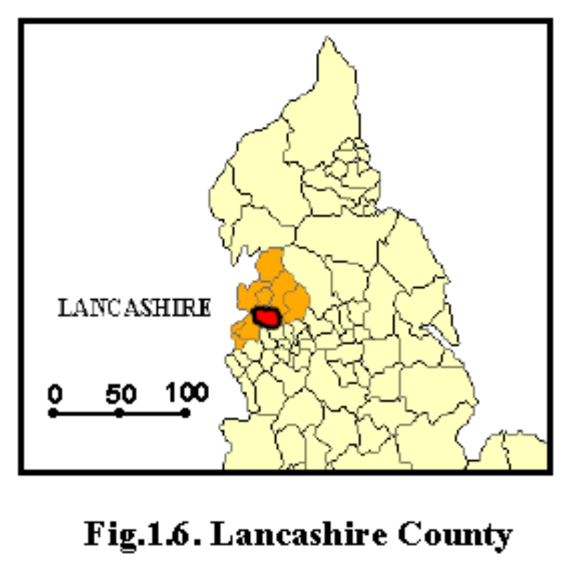
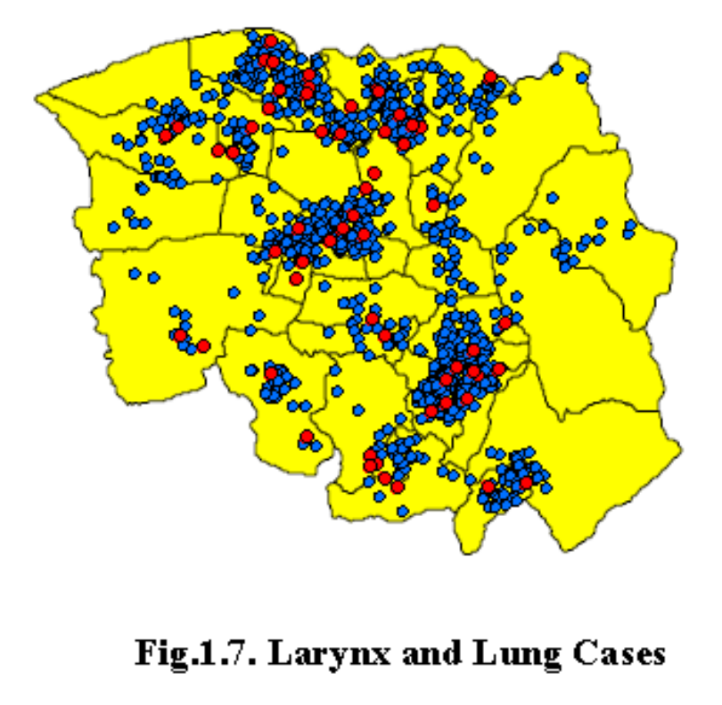
Lung and larynx cancer cases in Lancashire county, England during the period 1974-1983.
Here again it should be clear that clustering of such cancer cases is only meaningful relative to the distribution of population in this area.

Slide 13
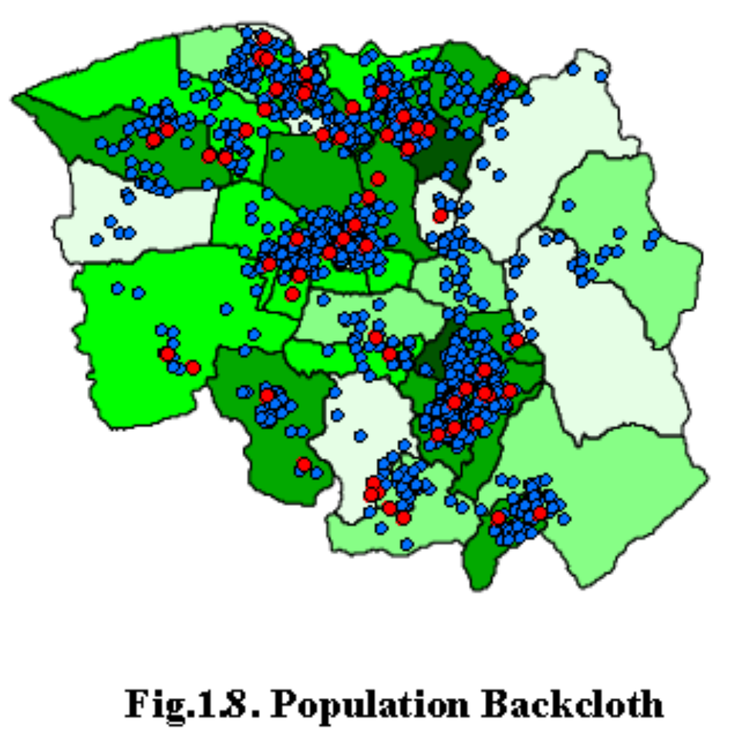
Lung and larynx cancer cases in Lancashire county, England during the period 1974-1983.
An examination of these population densities reveals that the clustering of cases in some of the lower central parishes is now much less surprising.
But certain other clusters do not appear to be so easily explained.
For example the central cluster in the far south appears to be in an area of relatively sparse population.

Slide 14
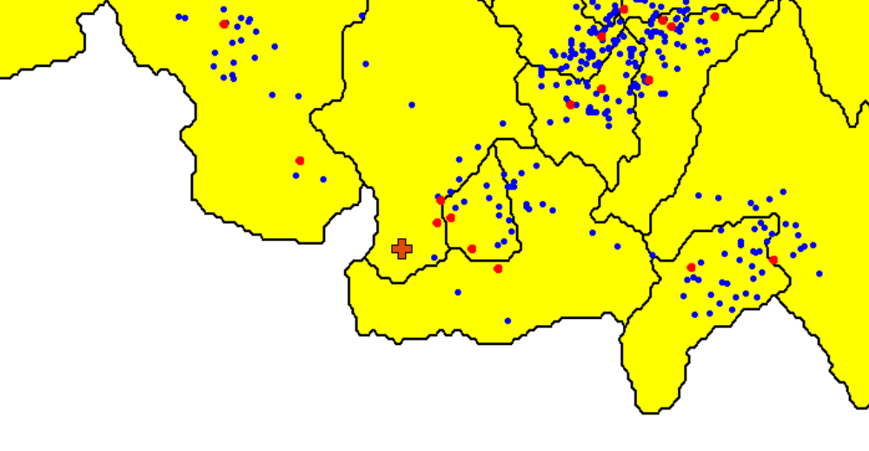
Lung and larynx cancer cases in Lancashire county, England during the period 1974-1983.
INCINERATOR
An enlargement of this southern portion indicates that a large incinerator is located just upwind of a cluster of cases.

Slide 15
Lung and larynx cancer cases in Lancashire county, England during the period 1974-1983.
INCINERATOR
Moreover, an examination of the composition of this cluster suggests that there are significantly more larynx cases present than one would expect, given the total distribution of cases.

Slide 16
Lung and larynx cancer cases in Lancashire county, England during the period 1974-1983.
INCINERATOR
This appears to be consistent with the fact that large airborne particles such as incinerator ash are more likely to lodge in the larynx rather than the lungs.

Slide 17
Lung and larynx cancer cases in Lancashire county, England during the period 1974-1983.
INCINERATOR
So there is some suspicion that this incinerator may be a significant factor contributing to the presence of this particular clustering of cases.

Slide 18
Lung and larynx cancer cases in Lancashire county, England during the period 1974-1983.
INCINERATOR
To analyze this question statistically, one may ask how likely it is that this could simply be a coincidence.
Here one must model the likelihood of such local clustering patterns.

Slide 19
Spatially continuous Data
Typical examples of such spatially continuous data might be
  geological measures on an ore deposit such as mineral grade, or
  the concentration of some pollutant, or
  soil salinity and permeability, or
  rainfall measurements
  Etc
These type of spatiallly continuous data is often referred to as geostatistical data.

Slide 20
Spatially continuous Data
Data comprise a set of point locations, but attached to each is a continuous measurement, such as the volume of rainfall measured at each site over a given time interval.
Our problem is not one of whether there is a pattern in the locations themselves; these are now simply the points at which sample measurements were taken.
Rather, we are interested in understanding the pattern in the values at these sample locations.
We can then perhaps use this understanding, to 'model' or estimate values of the variable of interest at
locations that were not part of the spatial sample.

Slide 21
Spatially continuous Data
This kind of problem is very common in the environmental sciences, where variables that describe soil, climate, geology, and so on, are inherently spatially continuous.
In other words, air pressure, temperature, and soil acidity, to name but a few variables, are measurable at any location on the earth's (or perhaps only land) surface.
But given that it is expensive, and ultimately absurd, to take measurements at vast numbers of locations, can we produce good estimates at locations that are not sampled?

Slide 22
Spatial variability of rainfall in California
Data:
  Recordings of average annual precipitation at a set of 30 monitoring stations, distributed across the state of California
  For these same sites we have measures of altitude, latitude, and distance from the coast, each of which is a possible covariate that might explain the variation in precipitation
Interest: explain spatial variation using the available covariates

Slide 23
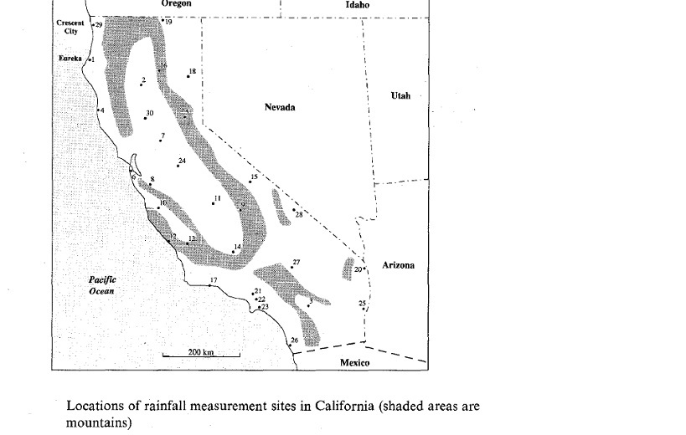
Spatial variability of rainfall in California

Slide 24
Spatial variability of rainfall in Sudan
Data
  measurements of total annual precipitation in 1942, 1962 and 1982, recorded at 31 sites
  sites are unevenly distributed across the region, with a preponderance of monitoring stations around the capital city of Khartoum, at the confluence of the White Nile and the Blue Nile
  no covariates

Slide 25
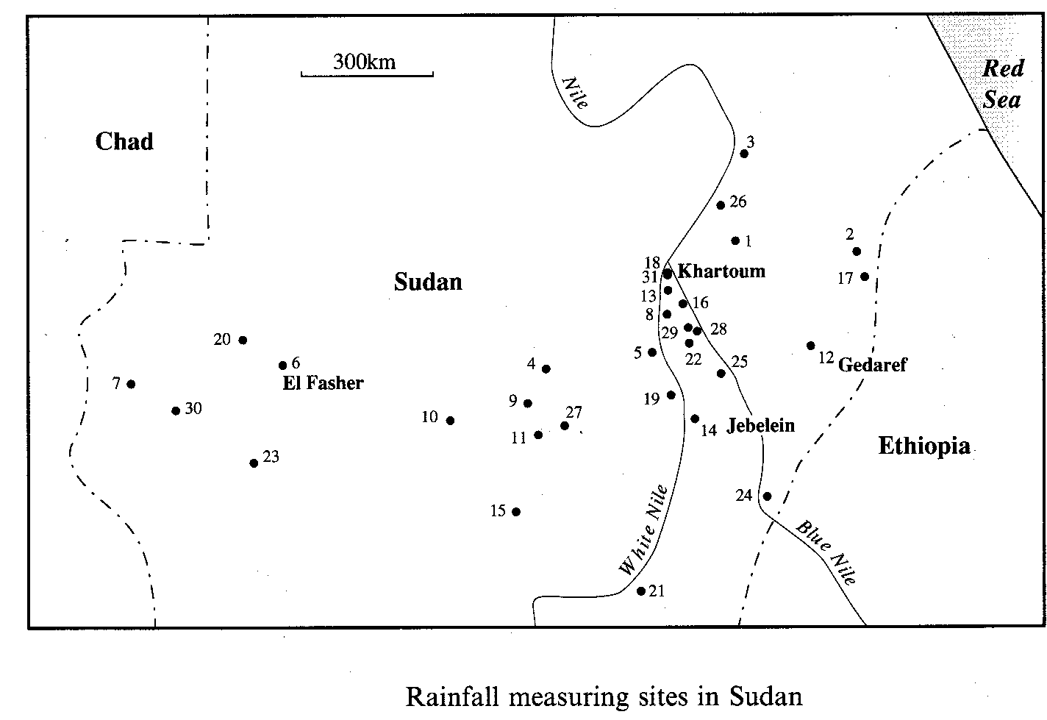
Spatial variability of rainfall in Sudan

Slide 26
Spatial variability of rainfall in Sudan
Interest
  seeing how annual rainfall varies across space
  how the nature of this spatial variability has changed over two twenty-year periods
  see to what extent rainfall is highly localized in space

Slide 27
Importance
area faces some of the most severe population pressures of any part of the Sahel region
The intensity of crop cultivation is considerable, and this, coupled with severely limited rainfall resources, has led to the desertification so characteristic of much of the wider region

Slide 28
Further considerations
Although the data available are rainfall totals for only three years it is well known that precipitation is highly variable from year to year.
Further, there is, of course, very great seasonal variability in rainfall, with the wettest months generally in July and August, though this seasonality itself varies geographically

Slide 29
Further considerations
when considering issues of desertification what matters more is not so much annual precipitation as seasonal and diurnal variation

Slide 30
Levels of Groundwater in Venice
In Venice withdrawals from several aquifers (the rock formations that contain water) at different depths have often been heavy, and have led to major problems of land subsidence.
The result has been that the local population has been exposed to the risk of flooding from the Adriatic Sea.
In order to be able to control the pumping from wells, hydrologists require accurate maps of the subsurface levels of groundwater (the so-called ‘piezometric’ surface).

Slide 31
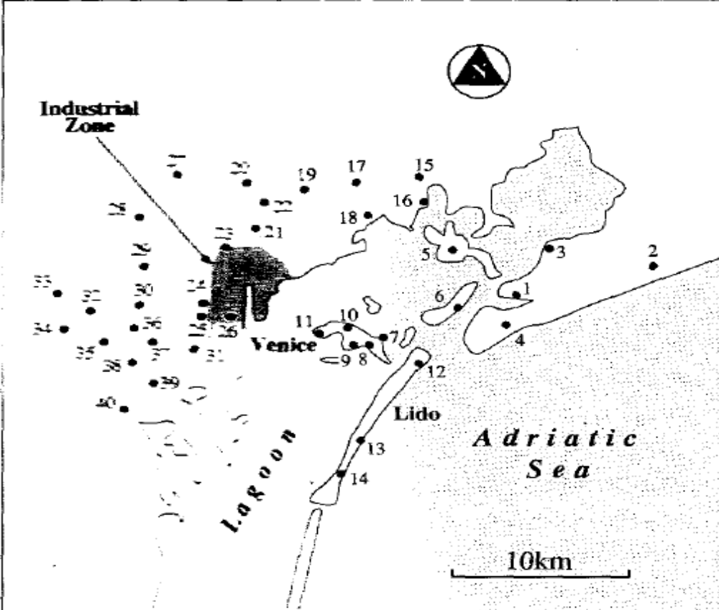

Slide 32
Levels of Groundwater in Venice
Data
  groundwater levels have been measured in 1973 and 1977.
  In 1973 data were measured for 40 sites; however, data for only 35 of these sites are available for 1977.
  Since 1973 withdrawals of groundwater from the major industrial area (Porto Marghera) have declined markedly, leading to a lower risk of subsidence and of saltwater intrusion into the freshwater aquifer

Slide 33
Levels of Groundwater in Venice
Interest
  Describe the nature of spatial variation as accurately as possible, in order to provide estimates of groundwater levels at locations that have not been sampled.
  How reliable these estimates are.

Slide 34
Radon measurements in Lancashire
Radon-222 is a naturally occurring radioactive gas produced by the decay of trace quantities of uranium.
Released to the atmosphere it is harmless but when trapped within buildings it can accumulate and is considered to be a serious risk factor for lung and possibly other cancers

Slide 35
Radon measurements in Lancashire
Levels of radon are highly variable in space, with levels in one property bearing little relationship to values in adjacent properties; this is thought to be a function of building materials, degree of ventilation and insulation, etc.

Slide 36
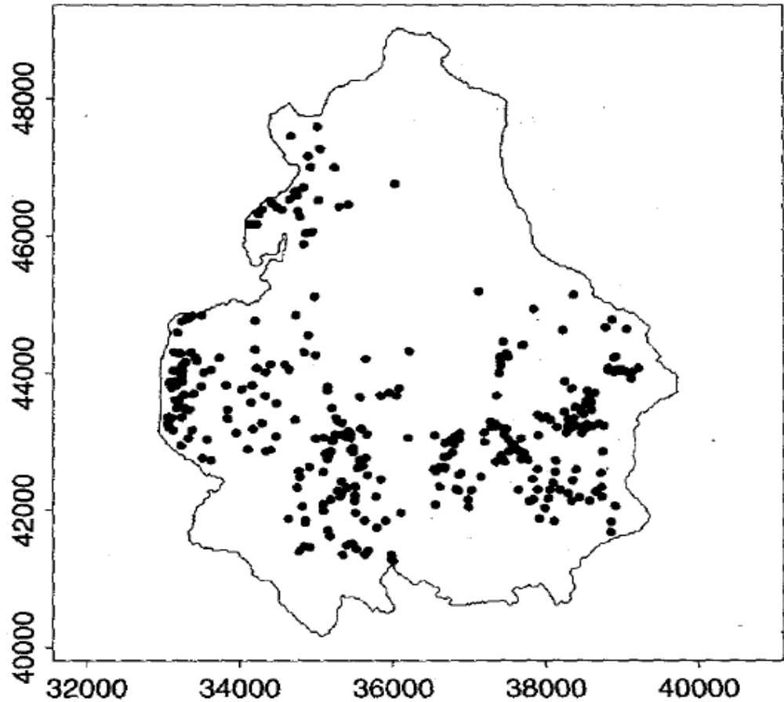

Slide 37
Radon measurements in Lancashire
Data
  Year 1989; 344 homes
  In general, the picture is of relatively low radon values to the west and south, higher values to the north and east
  This reflects the fact that the area to the west is covered by glacial deposits which trap the radon gas and prevent it rising to the surface. Further north and east there are no such surficial deposits and the gas escapes from the sandstones and limestones to the surface.

Slide 38
Radon measurements in Lancashire
Interest
  Understanding broad regional trends in more detail, and in examining if there is smaller scale variation superimposed on such trends.
  Interpolate the data the data to provide a regional map of radon levels
  Identify areas where sampling is ‘thin’ and needs to be improved.

Slide 39
Areal Data
We consider the analysis of data associated with spatial zones or areas.
The areas may
  form a regular lattice,
    as with remotely sensed images, or
    plots used in agricultural field trials
  be a set of irregular areas,
    such as postal or administrative districts
    Municipalities

Slide 40
Areal Data
Attributes associated with these areas cannot necessarily be assumed to vary continuously over space.
The given areas are considered to be the only spatial ‘locations’ at which the attributes can be measured
Our interest is not particularly in prediction of the value of the attribute at points in the study region at which it has not been observed, because it does not have a value ‘between areas’ and usually we have observed its value in all possible areas

Slide 41
Socio-economic data for Chinese provinces
Within the People’s Republic of China inequalities should not, in theory, exist, though since the mid-1970s the push towards higher levels of economic growth has meant that historical inequalities have persisted and been acknowledged as inevitable.
Industrialization has led, in general, to concentrations of the better paid and more educated in urban areas, with a poorer population in more rural areas.

Slide 42
Socio-economic data for Chinese provinces
We would like to be able to visualize and explore such spatial variations.
In doing so, we should acknowledge that such variations cannot sensibly be described by any one variable in isolation.
We need to recognize the multivariate nature of development processes and use appropriate statistical methods to characterize this.
What are the ‘components’ of development?
Can we analyze these and perhaps obtain some kind of socio-economic regionalization of the country

Slide 43
Socio-economic data for Chinese provinces
The data set comprises 18 socio-economic variables recorded in 1982, for the 29 major civil divisions in China.
The variables include measures of industrial and agricultural structure and economic performance, income, education and health

Slide 44
Description of socio-economic variables for Chinese provinces
1. Value of gross industrial output as % of total value of gross agricultural and industrial output
2. Tractor ploughed area as % of total cultivated area
3. Power irrigated area as % of total irrigated area
4. Electricity consumed in rural areas, in kWh, per member of commune laborr force
5. Consumption of chemical fertilizer in kilograms per hectare of sown area
6. Grain yield in jin per mu
7. Gross industrial output in Rmb per inhabitant
8. Gross output of coal industry in Rmb per inhabitant
9. Hospital beds per 10000 population
10. Doctors per 10000 population
11. University graduates per 10000 population
12. Students in secondary specialized schools per 10000 population
13. Urban population as % of total population
14. Fertility rate
15. Value of retail sales of consumer goods in Rmb per inhabitant
16. Net income in Rmb per person in rural communes
17. Expenditure of peasants on consumer goods in Rmb per person
18. Male deaths from cancer 1973—75, per 100 000 males

Slide 45
Areal Data
spatial data that has been aggregated to areal units such as regions or provinces or enumeration areas.
We have one or more variable whose values are measured per unit of these set of zones.
The problem is to understand the spatial arrangement of these values, to detect patterns, and to examine relationships among the set of variables

Slide 46
Census data for Enumeration Districts in the London Borough of Barnet
Multivariate measures arising from recorded census counts.
Classifications and regionalizations of such data are often used in the developed world, frequently for marketing purposes but more generally in planning contexts.
Census data exist in many countries at quite small geographical scales.
  In Britain, for example, such data are available for enumeration districts (EDs), areas that comprise, on average, maybe only 200 households

Slide 47
Census data for Enumeration Districts in the London Borough of Barnet
For any of the approximately 110,000 EDs used in the 1991 Census, several thousand counts are recorded, allowing rich descriptions of population and household structure, housing quality, employment, and so on.
Such data are of enormous value both to the public sector, concerned with areas such as the provision of health care and education, and to the private sector, where commercial companies want to ‘target’ or identify particular areas where their products or services might find a market.

Slide 48
Census data for Enumeration Districts in the London Borough of Barnet
The district of Barnet on the outskirts of north-west London was divided into 619 EDs for the 1991 Census

Slide 49
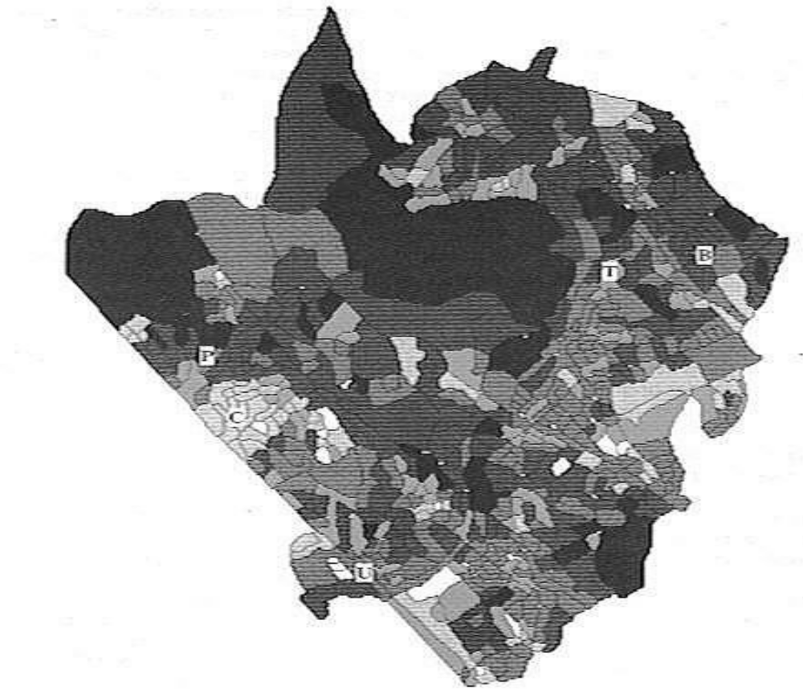

Slide 50
Census data for Enumeration Districts in the London Borough of Barnet
Data
  1. Private households -number of households (other than communal establishments) in an area
  2. Owner occupied-numbers of such households that are owned by the occupier
  3. Local authority-numbers of such households that are rented from the Local Authority (Council).
  4. No car
  5. Two cars
  6. Dependent children-number of households with ‘dependent’ children, aged under 15
  7. Single parents-number of households containing at least one single parent family.
  8. Pensioners-a count of households comprising one or more pensioners
  9. Lone female pensioners-subset of households comprising a woman aged at least 75, living alone
  10. Migrants-a count of households containing members who were living at a different address one year before the census was taken

Slide 51
Census data for Enumeration Districts in the London Borough of Barnet
Such counts can of course be analyzed directly, but it will almost always be sensible to calculate new variables as proportions or percentages of the total number of households, or some other suitable denominator
In most cases we can use total numbers of households as a denominator.
However, when looking at single parents it may be more sensible to use the number of households with dependent children, while with elderly women living alone we could use the total number of households containing pensioners as a ‘base’ variable

Slide 52
Census data for Enumeration Districts in the London Borough of Barnet
Note: counts in some EDs will be very small.
This means that estimates of rates and proportions in such areas may be unreliable.
Can we perhaps use the spatial (proximity) information in the data to ‘smooth’ out such variations and obtain more reliable maps of rates?
Alternatively, we may use the multivariate nature of the data to construct socio-economic ‘scores’ for the EDs and to group together those EDs that seem to be similar in composition.

Slide 53
Census data for Enumeration Districts in the London Borough of Barnet
Such a strategy is widely used in marketing, but also in health research. In applications such as these, researchers often want simple, ‘shorthand’, ways of describing the character of an area.
As a result, both academic researchers and commercial companies have invested considerable time and money in devising multivariate classifications and ‘scoring’ areas in particular ways.

Slide 54
Census data for Enumeration Districts in the London Borough of Barnet
Suppose we wish to make estimates of a census variable for areas other than the EDs for which the data are published?
For example, many businesses organize sales programs not around EDs or simple aggregations of these, but rather based on postcode sectors.
The boundaries of these areas cut across those of EDs in arbitrary ways.
This poses a general problem with the analysis of area data, that of cross-areal interpolation.
In other words, can we use data recorded within one set of zones to estimate data for an alternative set; can we interpolate ED data to match postcode sector boundaries?

Slide 55
Interaction Data
patterns of flows from a set of locations (either points or areas) to another location.
Objective: to model the pattern of flows in terms of the geographical accessibility of ‘destinations’ relative to ‘origins’, and in terms of the ‘demand’ at ‘origins’ and the ‘attractiveness’ of ‘destinations’

Slide 56
Interaction Data
We wish to understand the arrangement of flows. to build models of such flows. and maybe to use this information in making predictions about how the flows may change under certain scenarios.

Slide 57
Interaction Data
A typical example arises in a health context, where the origins may be areas of residence, which give rise to particular numbers of patients requiring treatment; these patients are then referred (or ‘flow’) to a set of destinations such as hospitals or clinics.
Another example comes from retailing, where we have a set of origin zones, generating demand for consumable goods; these demands are satisfied by retail centers and shoppers travel from origins to retail destinations

Slide 58
Interaction Data
In other cases our interest might be in freight flows, population migration, or journeys-to-work.
Primary objective in the analysis of interaction data: to understand or model the pattern of flows.
If we can model such data we might then be in a position to use such a model for planning purposes.

Slide 59
Interaction Data
For example, if we can adequately capture the way in which patients ‘interact with’ hospitals we can perhaps experiment with modifications to the health care delivery system; what is likely to happen to the pattern of flow if we close a particular hospital or if we add a new service to a hospital?

Slide 60
Interaction Data
If we can achieve a good description of the current configuration of flows from consumer origins to retail destinations then we can speculate, with some confidence perhaps, on what might happen if a new store were to be opened in one of the zones, or if a new residential estate (generating further retail demand) were to be built.

Slide 61
Interaction Data
It is acknowledged that there will be a myriad of reasons why individuals might choose to shop in one set of locations rather than another; similarly, there will be reasons (and health service constraints) why particular individuals visit, or are referred to, particular health centers.

Slide 62
Interaction Data
Our interest here lies in examining the spatial behavior of collections of individuals, rather than individuals themselves.

Slide 63
Interaction Data
How, then, do we explain such aggregate spatial interaction?
Typically, we can recognize three important sets of factors:
  The spatial separation of origins from destinations
  Various characteristics which determine the volume of flow from each origin
  Various characteristics of the destinations which relate to their ‘attractiveness’.

Slide 64
Interaction Data
The first relate to the way in which spatial separation or distance constrains, or impedes, movement.
In general we will refer to this as the ‘distance’ between an origin i and a destination j
At relatively large scales of geographical inquiry (such as the regional scale) this might simply be the straight-line (Euclidean) distance separating an origin from a destination.

Slide 65
Interaction Data
In other cases (perhaps within an urban area) it might be the travel time, cost of travel, perceived journey time, or any other sensible measure of the separation of origins and destinations.

Slide 66
Interaction Data
It is sometimes the case that interaction modeling is carried out in situations where origins and destinations are nodes on a transport network and flows are restricted to the arcs of that network.
A sensible measure of distance from an origin node to a destination node would then be the shortest distance between them, whether measured as arc length or travel time.

Slide 67
Interaction Data
The second set of factors concerns the ability of the origin zones to generate or produce a flow.
This might be measured as a single variable.
For example, in a retailing context we might have data on the known, or estimated, expenditure of residents on retail goods, while in a health context we might use some measure of population size, suitably modified to allow for the fact that (depending on the particular health care application) some types of people will demand the service more than others.

Slide 68
Interaction Data
The important point to note is that before we begin to model the flows we may need to model ‘trip generation’.
It is to be expected that there exists a positive relationship between the volume of flow generated from an origin and some suitable measure of the size of the origin.

Slide 69
Interaction Data
3rd component: the representation of the ‘attractiveness’ of destinations.
We could measure this by variables such as the volume of floor space in the retailing context, or number of hospital beds in the health care context.
Again, we shall expect to observe a positive relationship between volume of flow to the destination and the size of that destination.

Slide 70
Interaction Data
But there may be other factors related to the attractiveness of destinations.
  For example, in modeling the migration of people among provinces, we could measure the ‘attractiveness’ of destinations in terms of factors such as job opportunities (or unemployment rates), crime rates, climatic characteristics, and so on.

Slide 71
Spatial Analysis vs Spatial Data Analysis(SDA)
SDA is a subset of Spatial Analysis
SDA is with the situation where observational data are available on some process operating in space and methods are sought to describe or explain the behaviour of this process and its possible relationship to other spatial phenomena

Slide 72
Spatial Analysis vs Spatial Data Analysis
The object of data analysis is
  to increase our basic understanding of the process,
  assess the evidence in favour of various hypotheses concerning it, or
  possibly to predict values in areas where observations have not been made.
The data with which we are concerned constitute a sample of observations on the process from which we attempt to infer its overall behaviour.

Slide 73
Spatial Analysis vs Spatial Data Analysis
By defining spatial data analysis in this way we place ourselves firmly in the area of statistical description and modelling of spatial data and accordingly restrict attention to a particular set of methods.
In doing so we have to exclude from our coverage some important quantitative methods which would be included under the more general heading of spatial analysis.

Slide 74
Spatial Analysis vs Spatial Data Analysis
For example, although we discuss very briefly various forms of network analysis, such as those concerned with routing problems, minimisation of transportation costs or the optimal siting of facilities.
These classes of problem do, of course, involve spatial data, but not primarily observational data of the type discussed above; these problems instead involve mathematical optimisation techniques.

Slide 75
Spatial Analysis vs Spatial Data Analysis
There are clearly areas where such methods do interact with those with which we are concerned and have defined as spatial data analysis.
For example, network analysis may be useful to compute travelling times, which are then used as measures of spatial proximity in the modelling of some observed spatial process of interest.
Alternatively, models of observational data on movement
of people or goods between locations, may provide necessary input to methods concerned with the optimal siting of facilities.

Slide 76
Summary
Spatial data analysis is involved when data are spatially located and explicit consideration is given to the possible importance of their spatial arrangement in the analysis or in the interpretation of results.

Slide 77
Next Topic: Point Patterns

